Slide 1

You are the best teacher.
mr. beccerra.

Slide 2
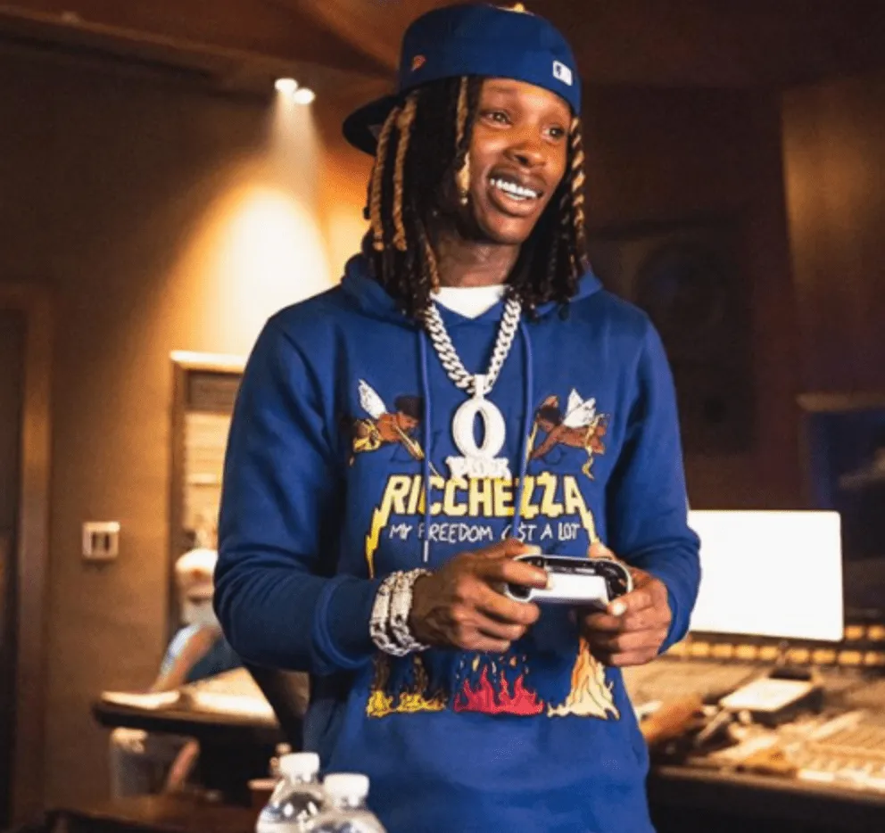
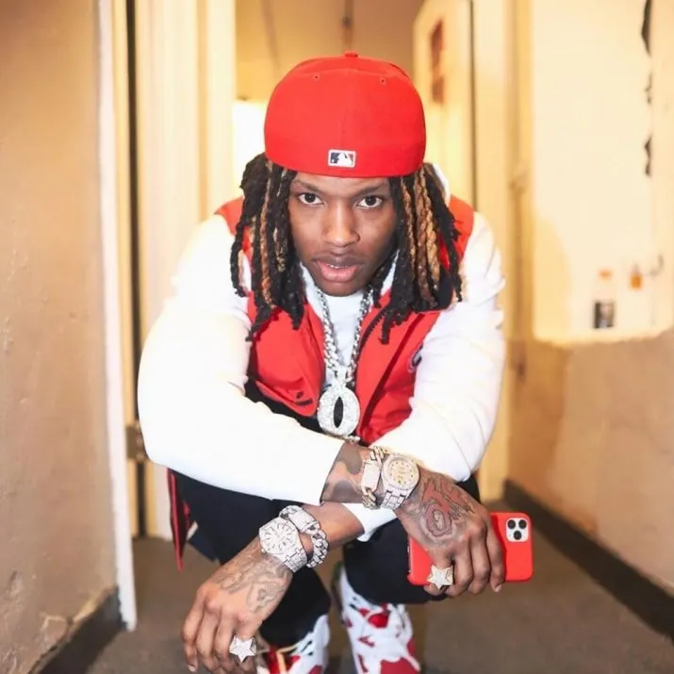
You are very cool and I this your favorite rapper

Slide 3

01
You are very cool

Slide 4
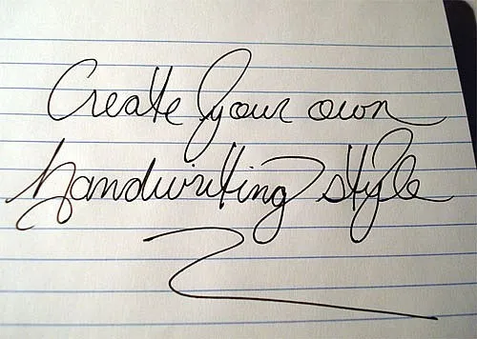
Even though you make me write

Slide 5
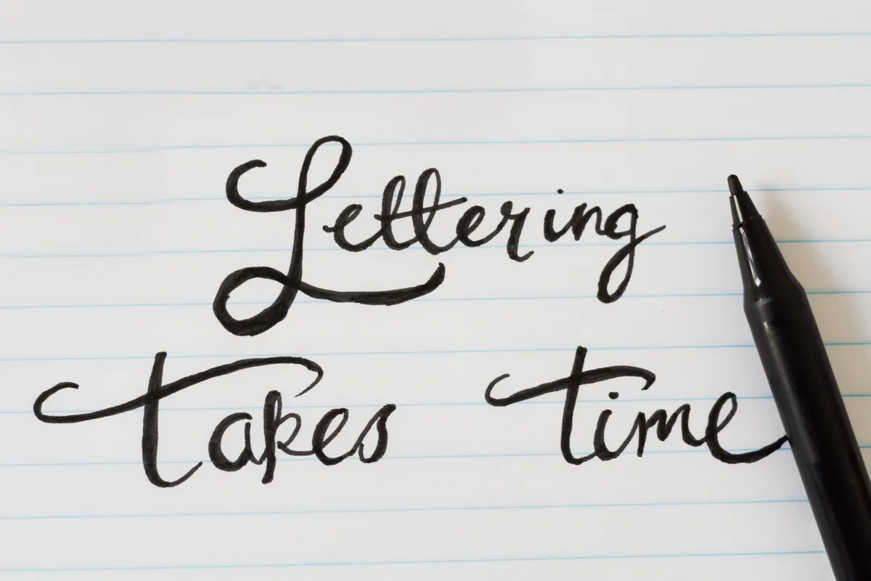
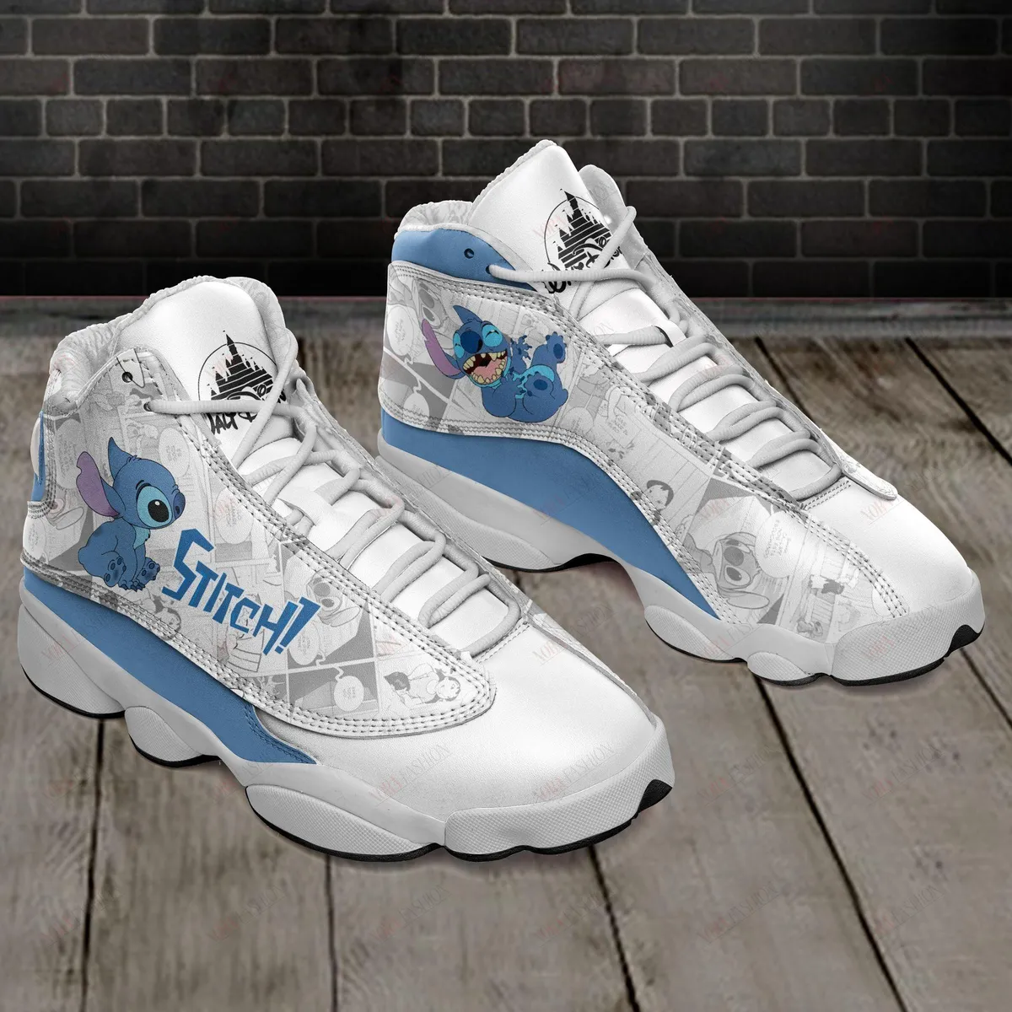

Ipsum
Dolor Sit
But you are the best teacher ever and like your jordans and your laugh and your hand writing .

Slide 6


Thank you for everything.

